Slide 1
Class 3.5 – Classes and objects
Class 3.5 – 12/17/18
Instructor: Hank dedona

Slide 2
Class 3.4 recap
Talked about gradle dependencies and their scopes (implementation, runtime, test)
Thyme templates
th:text
th:unless
th:fragments
th:href and th:src
Spring @RequestParams for query parameter injection

Slide 3
3 pillars of oo programming
Polymorphism
Polymorphism allows the expression of some sort of contract, with potentially many types implementing that contract (whether through class inheritance or not) in different ways, each according to their own purpose.
Inheritance
Inheritance is a mechanism wherein a new class is derived from an existing class. In Java, classes may inherit or acquire the properties and methods of other classes. A class derived from another class is called a subclass, whereas the class from which a subclass is derived is called a superclass.
Encapsulation
Encapsulation in Java is a mechanism of wrapping the data (variables) and code acting on the data (methods) together as a single unit. Declare the variables of a class as private. Provide public setter and getter methods to modify and view the variables values.

Slide 4
A minimal class & object
public class HelloWorld {
String message = "Hello World"; ‘
void sayHello() {
System.out.println(message);
}
}
This class contains fields (the data or variables, in this case a String message) and methods (the behaviors, in this case sayHello() that returns nothing).

Slide 5
Running our minimal class
public class HelloWorldRunner {
public static void main(String[] args) {
HelloWorld hello = new HelloWorld(); // Create new instance of HelloWorld object
hello.sayHello(); // Call sayHello() method on object
}
}

Slide 6
The this Keyword
The this keyword refers to any variable, method, etc within the class (or put in other words, itself).
Using the previous example:
public void sayHello() {
System.out.println(this.message); // This refers to the variable message inside the class
}

Slide 7
This keyword example
public class HelloWorld {
String message = "Hello World";
public void sayHello() {
String message = "Goodbye World";
System.out.println(message); // prints "Goodbye World"
System.out.println(this.message); // prints "Hello World"
}
}

Slide 8
Access modifiers
Public: Anybody can access it (the world)
Private: Only the class can access it (nobody else)
Protected: Package and subclasses can access it
Default (package private in Java): Only classes in the same package can access it

Slide 9
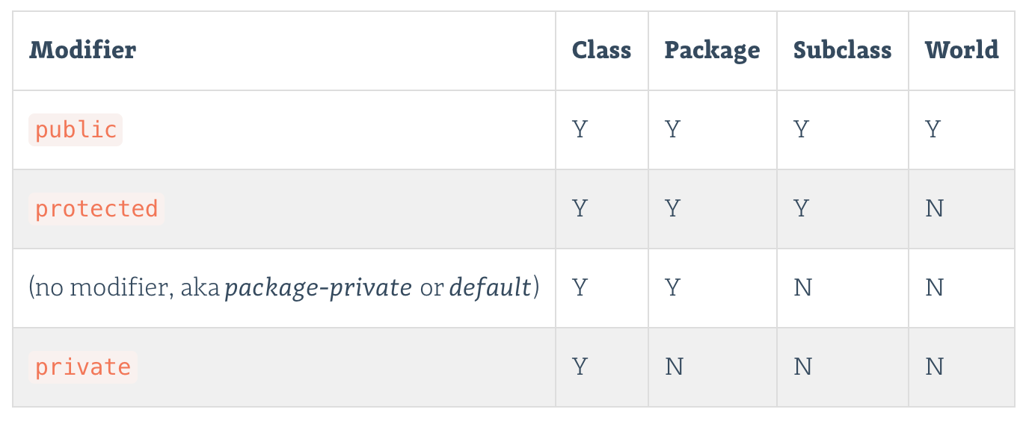

Slide 10
Refactored hello
public class HelloWorld {
private static final String MESSAGE = "Hello World";
public void sayHello() {
System.out.println(message);
}
}
Note: I updated message to not only be private, but to be static and final. This is because the value is hard coded and never changes. This is an example of a constant variable.

Slide 11
Launchcode on access modifiers
In Java, you should always use the most restrictive access modifier possible. Minimizing access to class members allows code to be refactored more easily in the future, and hides details of how you implement your classes from others.
This makes your code more modular and modifiable. Each public member that you expose is another field or property that can be referenced directly elsewhere in any program using your class. Thus, changing any such field in your code could potentially break any code referencing such members. The fewer public members, the more you can change your code without breaking stuff elsewhere.

Slide 12
Me on access modifiers
Data protection is important, as such, all variables within a class should be declared as private first. If necessary, you can increase their visibility (or access modifier), but really should have setters/getters and still be private.
If at all possible, objects should be immutable whenever possible. This means declaring all objects as private and not providing public mutators.
Immutable objects are inherently thread safe and can be passed around between multiple threads in an application since the data can never be changed, we don’t have thread locking issues or visibility issues.

Slide 13
Student class (If I wrote it)
private final String studentName; private final int studentId; private final int numCredits; private final double gpa; public Student(String studentName, int studentId, int numCredits, double gpa) { this.studentName = studentName; this.studentId = studentId; this.numCredits = numCredits; this.gpa = gpa; }
// Getters below

Slide 14
Fields
Fields are just another way to say variables of your class. In the student example this would include their name, id, credits and gpa.
These are INSTANCE variables which are created when the class is instantiated.
These are different from STATIC variables which are created for the class and do not require the class to be instantiated.

Slide 15
GETTERS & Setters
We’ve already mentioned getters and setters before.
Getters: Return values (usually private) from a class
Setters: Sets values (usually private) for a variable in a class
public String getName() { return name; } // getter
public void setName(String aName) { name = aName; } // setter

Slide 16
Why use setters?
The main reason for using setters and not allowing users of your classes to access variables via public is for input validation.
If you have a setter you can check a bunch of things
Make sure it’s not null or blank
Make sure it’s a valid input (a-z, etc)
You can also limit the visibility to classes that need access based on the access modifier (e.g. set the setter to package-private only allowing classes within the same package to modify values).
Note: This becomes way more important when you work on bigger projects with multiple people!

Slide 17
constructors
We’ve been using constructors already (whenever we instantiate an object using the NEW keyword).
E.g. List<String> myList = new ArrayList<>();
They are declared without a return type. Any function that is named the same as the class and has no return type is a constructor.

Slide 18
Helloworld 2.0
public class HelloWorld {
private String message = ""; // Set to empty string (or null)
public HelloWorld(String message) {
this.message = message;
}
public String getMessage() { return message; }
public void setMessage(String aMessage) { message = aMessage; }
}
Based on this code, you cannot instantiate an instance of this HelloWorld class without providing a message to the constructor.
E.g. HelloWorld goodbye = new HelloWorld("Goodbye World"); // Message is required

Slide 19
Overloading constructors
It is valid (and fairly common) to have multiple constructors in the same class, this is known as OVERLOADING the constructor (methods can be overloaded as well).

Slide 20
Overloaded constructor example
public Student(String name, int studentId, int numberOfCredits, double gpa) {
this.name = name;
this.studentId = studentId;
this.numberOfCredits = numberOfCredits;
this.gpa = gpa;
}
public Student(String name, int studentId) {
this(name, studentId, 0, 0.0); // Calls the constructor above with the values provided
}
Note: The THIS keyword is how you call constructors within your class

Slide 21
Calling our new student constructors
Based on the two new constructors in the previous slide we can instantiate student objects one of two ways. Both are valid!
1) Student student1 = new Student(“Student1”, 1, 12, 3.5);
2) Student student2 = new Student(“Student2”, 2);

Slide 22
Defining constructors
When defining constructors, think about:
Which fields must be initialized for your class to work properly? Be sure you initialize every such field.
Which fields should be initialized by the user creating an object, and which should be initialized by the class itself?
What are the use-cases for your class that you should provide for?
It is not a good idea to leave potentially null or invalid values after constructing an instance of your class.

Slide 23
Final fields (variables)
A final field is one that can not be changed once it is initialized. This means slightly different things for primitive and class types.
Final primitive fields can not change their value once they are initialized.
Final object fields may not change the object that they hold once they are initialized. However, that object itself may change.
What this means is that you can set an object value and that value may change, but values within the object itself may change.

Slide 24
Static fields (variables)
We’ve already used static fields/variables throughout this class.
These are class-level fields.
Shared among all instances of a given class.

Slide 25
constants
I’ve already introduced you to constant variables in my refactored hello class example.
Constants are created using a combination of the static and final keywords.
E.g. private static final String MESSAGE = "Hello World";
E.g. 2 public static final double PI = 3.14159;
The variable “MESSAGE” and “PI” can never be changed.
Note: constants are ALL CAPS and delimited by UNDERSCORES

Slide 26
Next…
Studio: Restaurant Menu
https://education.launchcode.org/skills-back-end-java/studios/restaurant-menu/

